Slide 1


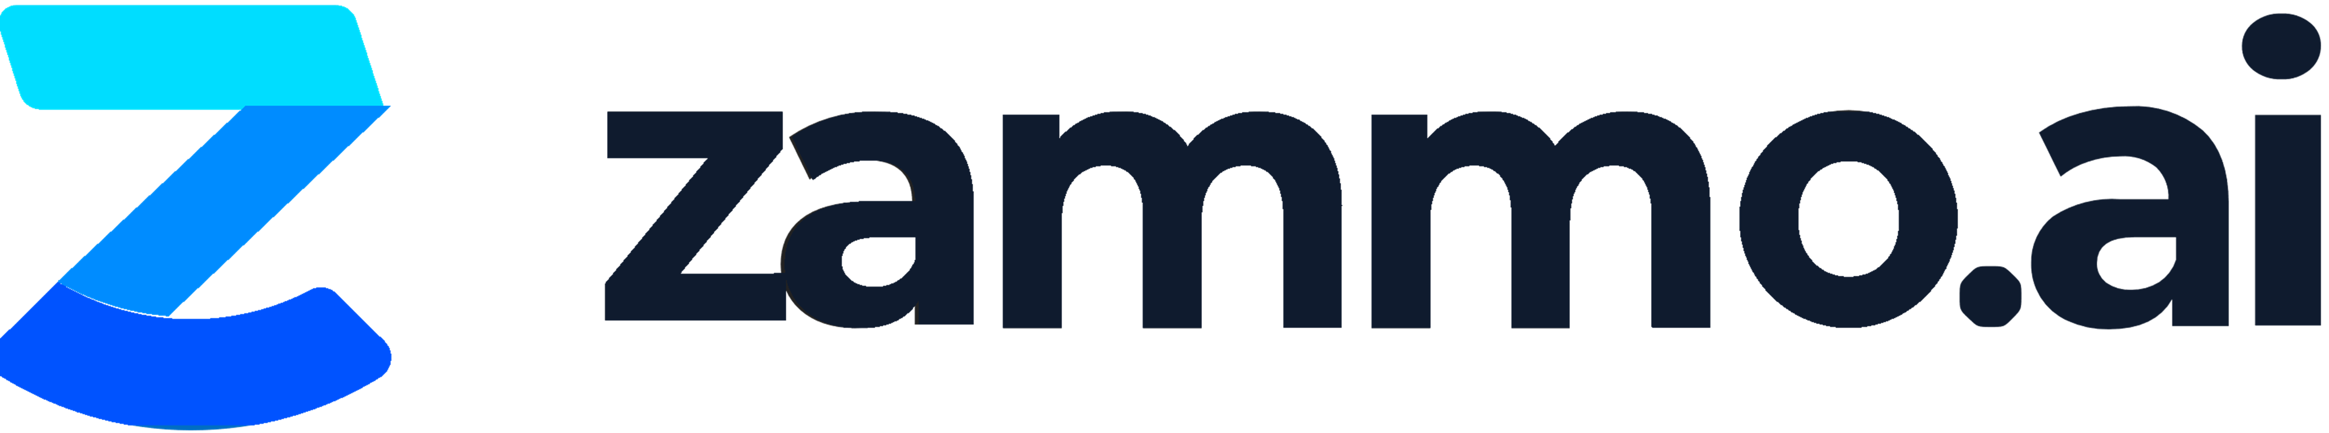
Conversational Azure OpenAI (ChatGPT) Accelerator
Contact centers are understaffed and overwhelmed
Contact centers are facing growing pressure to adapt digital experiences for delivery of enhanced multi-modal content. The centers must also minimize additional costs and improve operational efficiency. Existing system are overwhelmed, provided limited solutions for ADA and multilingual needs, and require worders to spend valuable time manually routing calls and answering simple frequently asked questions.
The Zammo Conversational Azure OpenAI Accelerator is built on Microsoft Azure and combines AI Cognitive Services and machine learning into a user-friendly platform. This enables you to create content once and deploy it simultaneously to multiple channels with a single click.
Leveraging the most advanced AI has been time consuming and required expensive IT resources, until now.
Cut Costs
Let the business lead! Marketing, Contact Center or HR leads. IT only get involved to connect to backend systems.
Bring Efficiency
Automate large volume of repetitive inquiries in your existing communications channels, including live agent transfer.
Grow Revenue
Communicate and transact on new and existing channels to reach additional audiences.
Improve Internal & External Customer Experience
24/7 omni-channel experience in multiple languages; unique voices for avatars and unified user engagement analytics.
Most Powerful Today & Future-Proofed for Tomorrow
Microsoft’s most advanced natural language processing (NLP) today, and Azure OpenAI/GPT-3.
©Microsoft Corporation. All rights reserved.

Slide 2



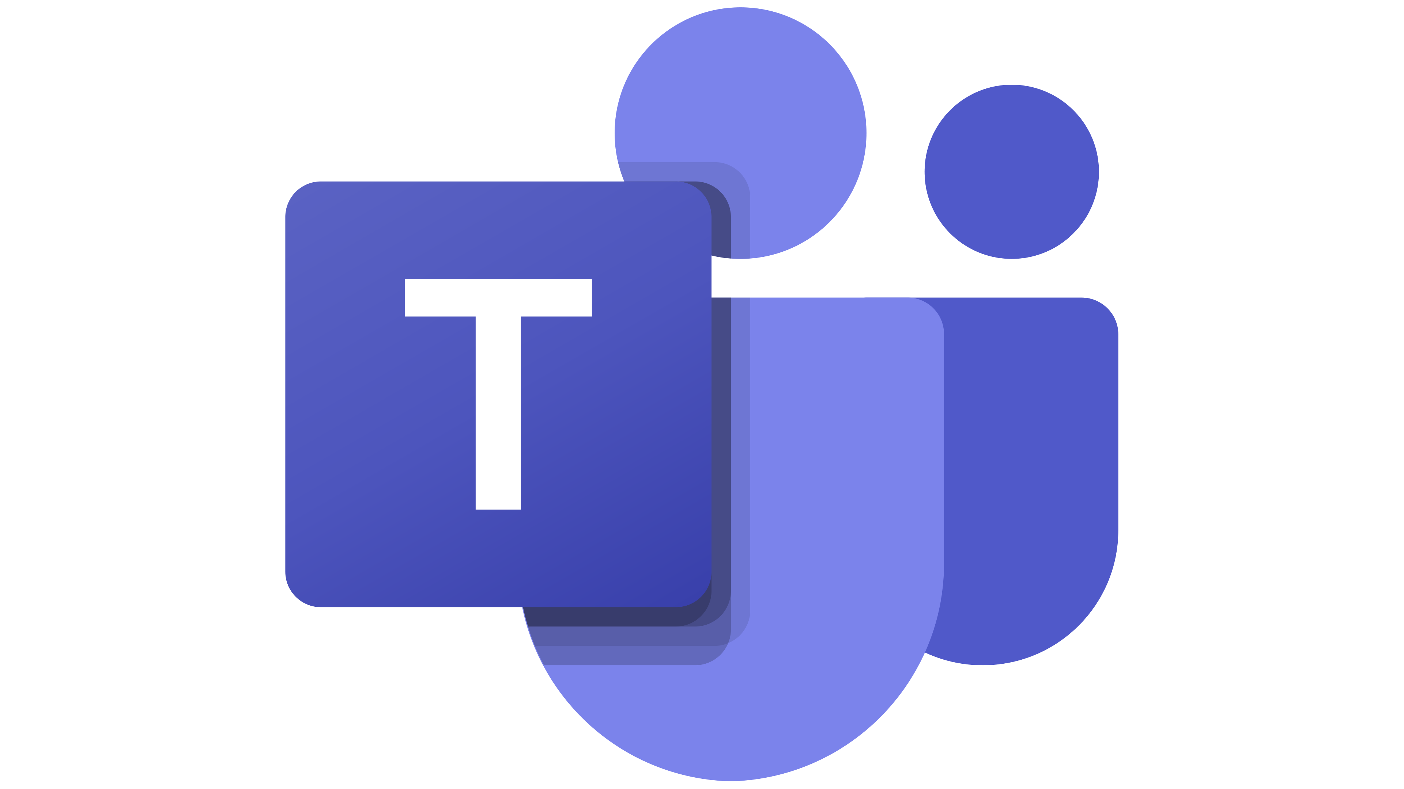





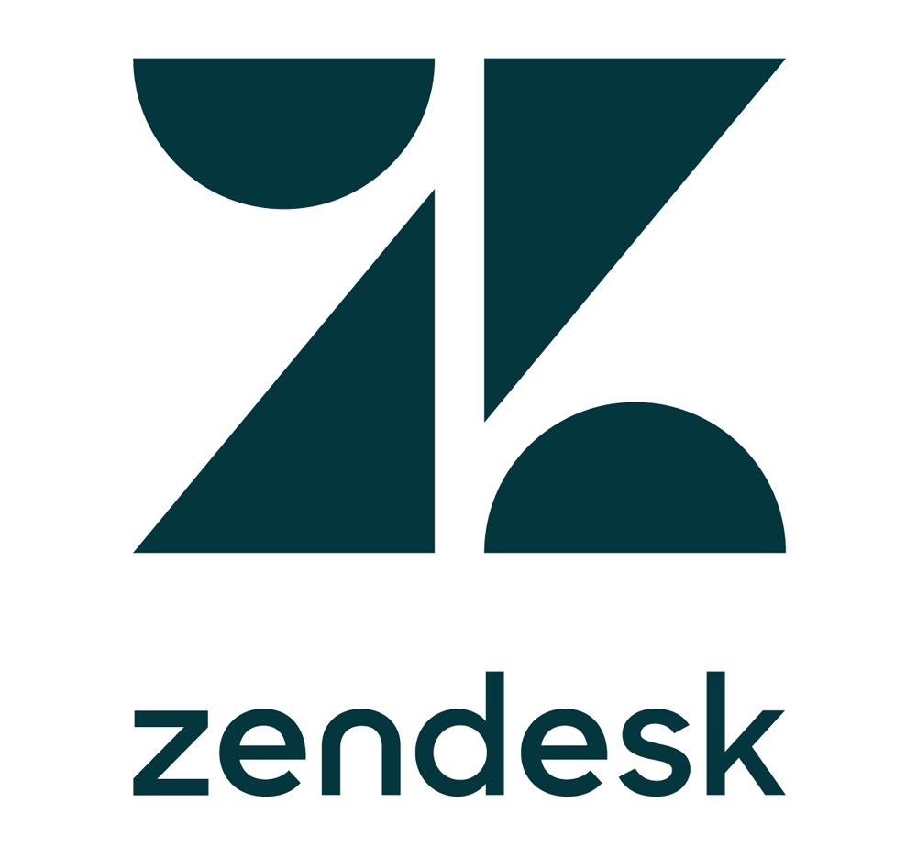

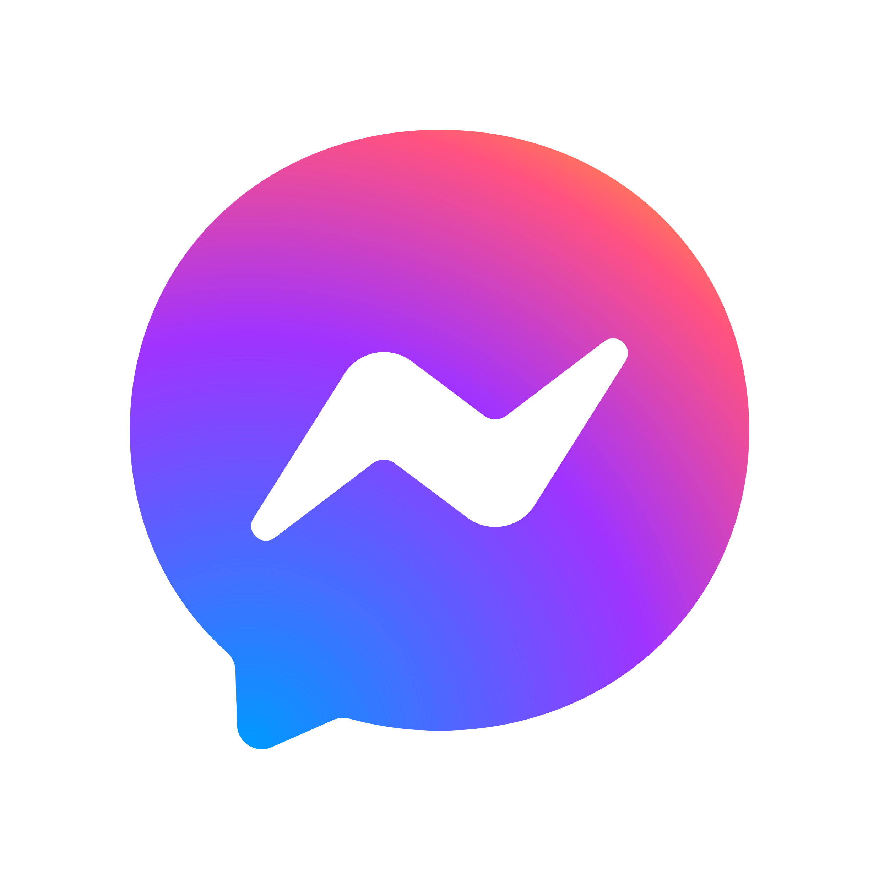
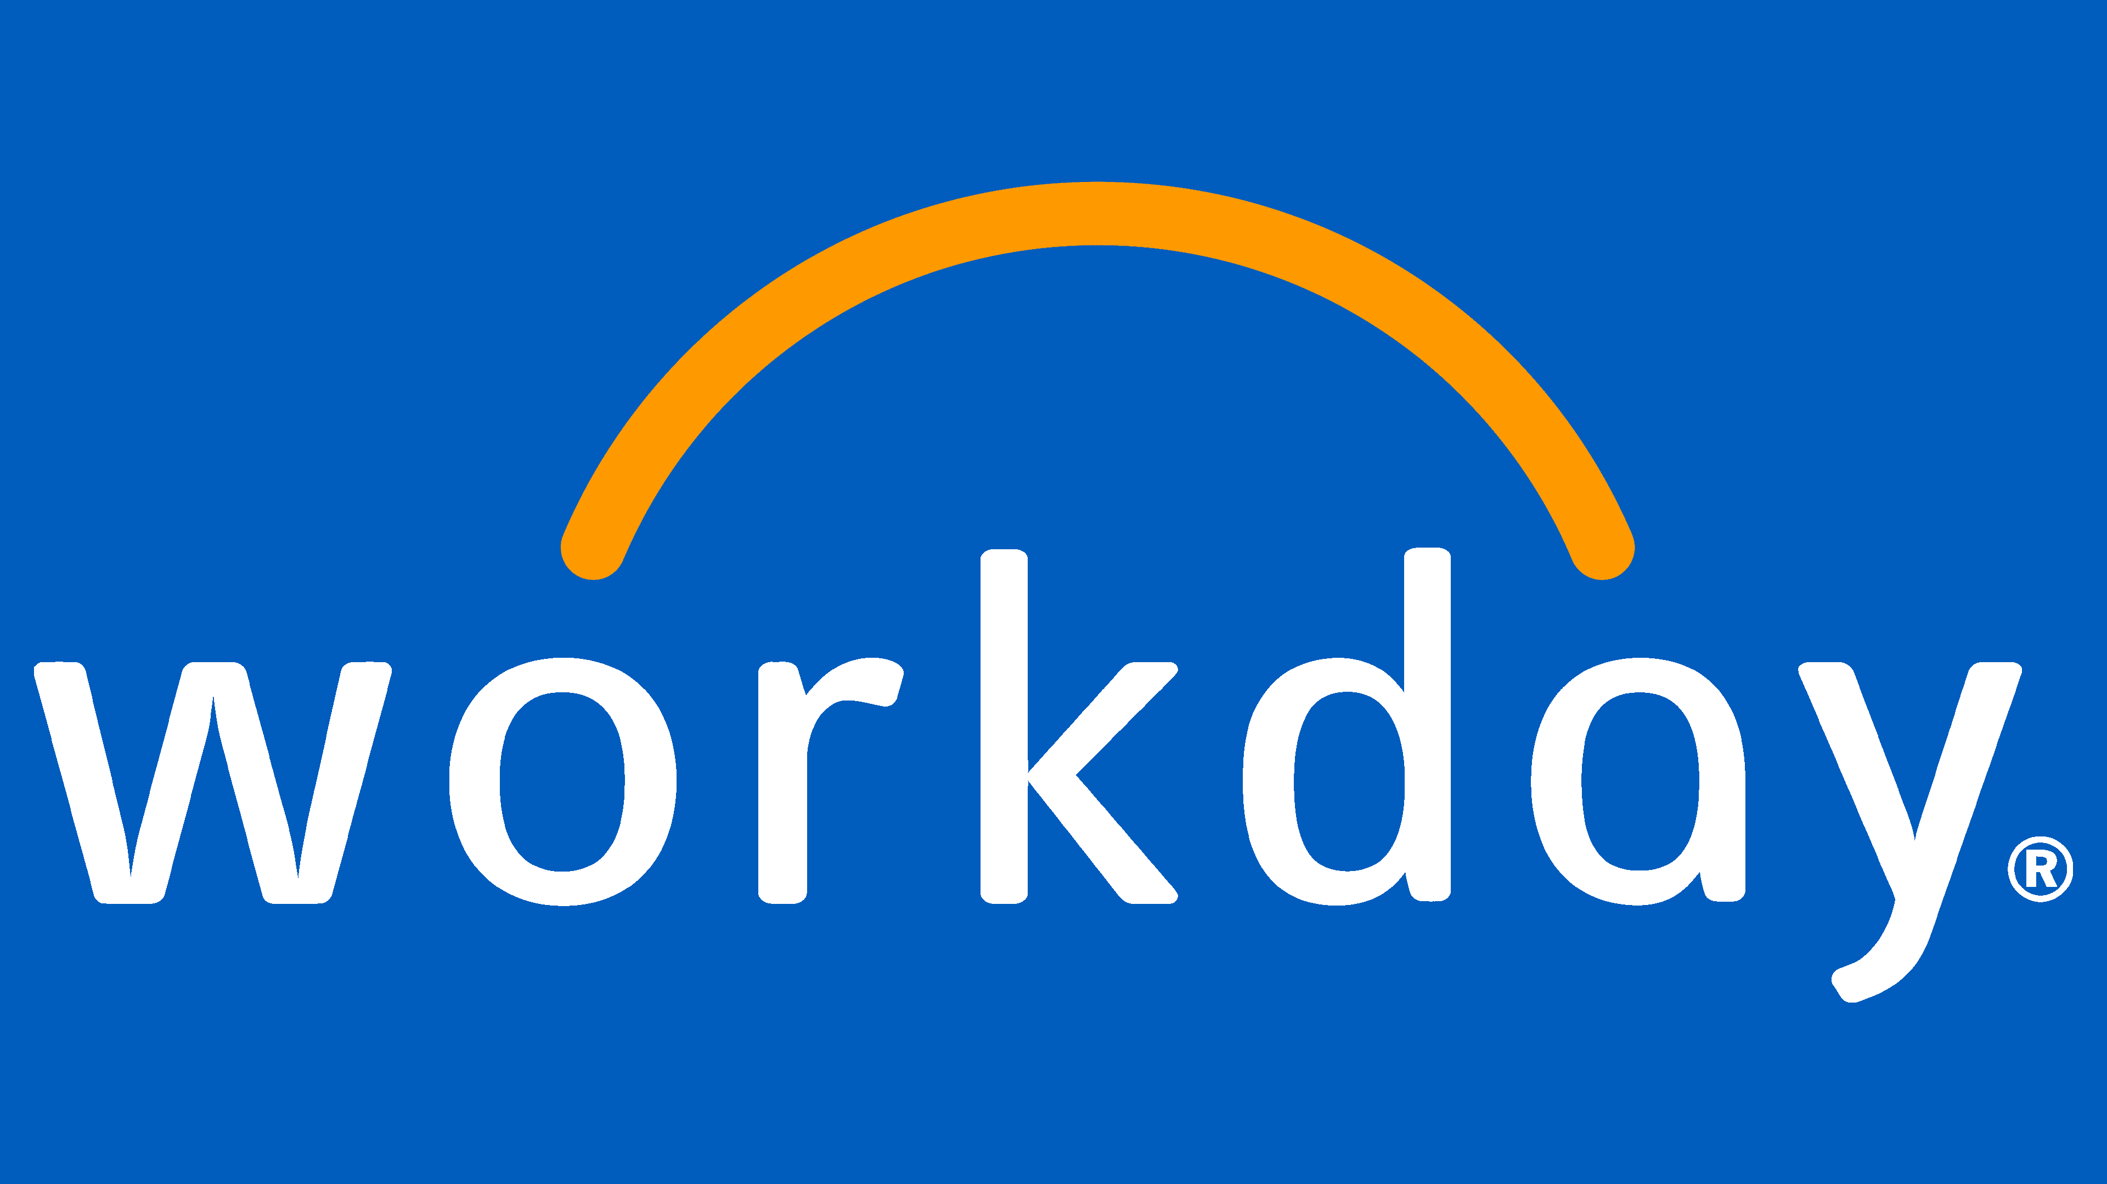
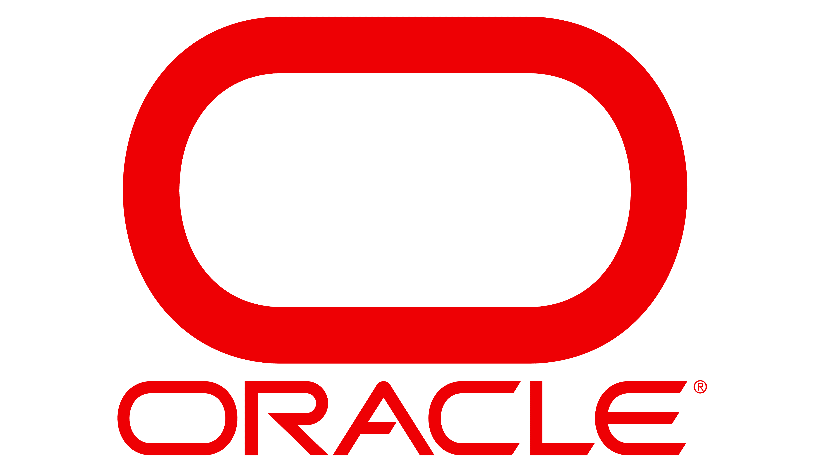


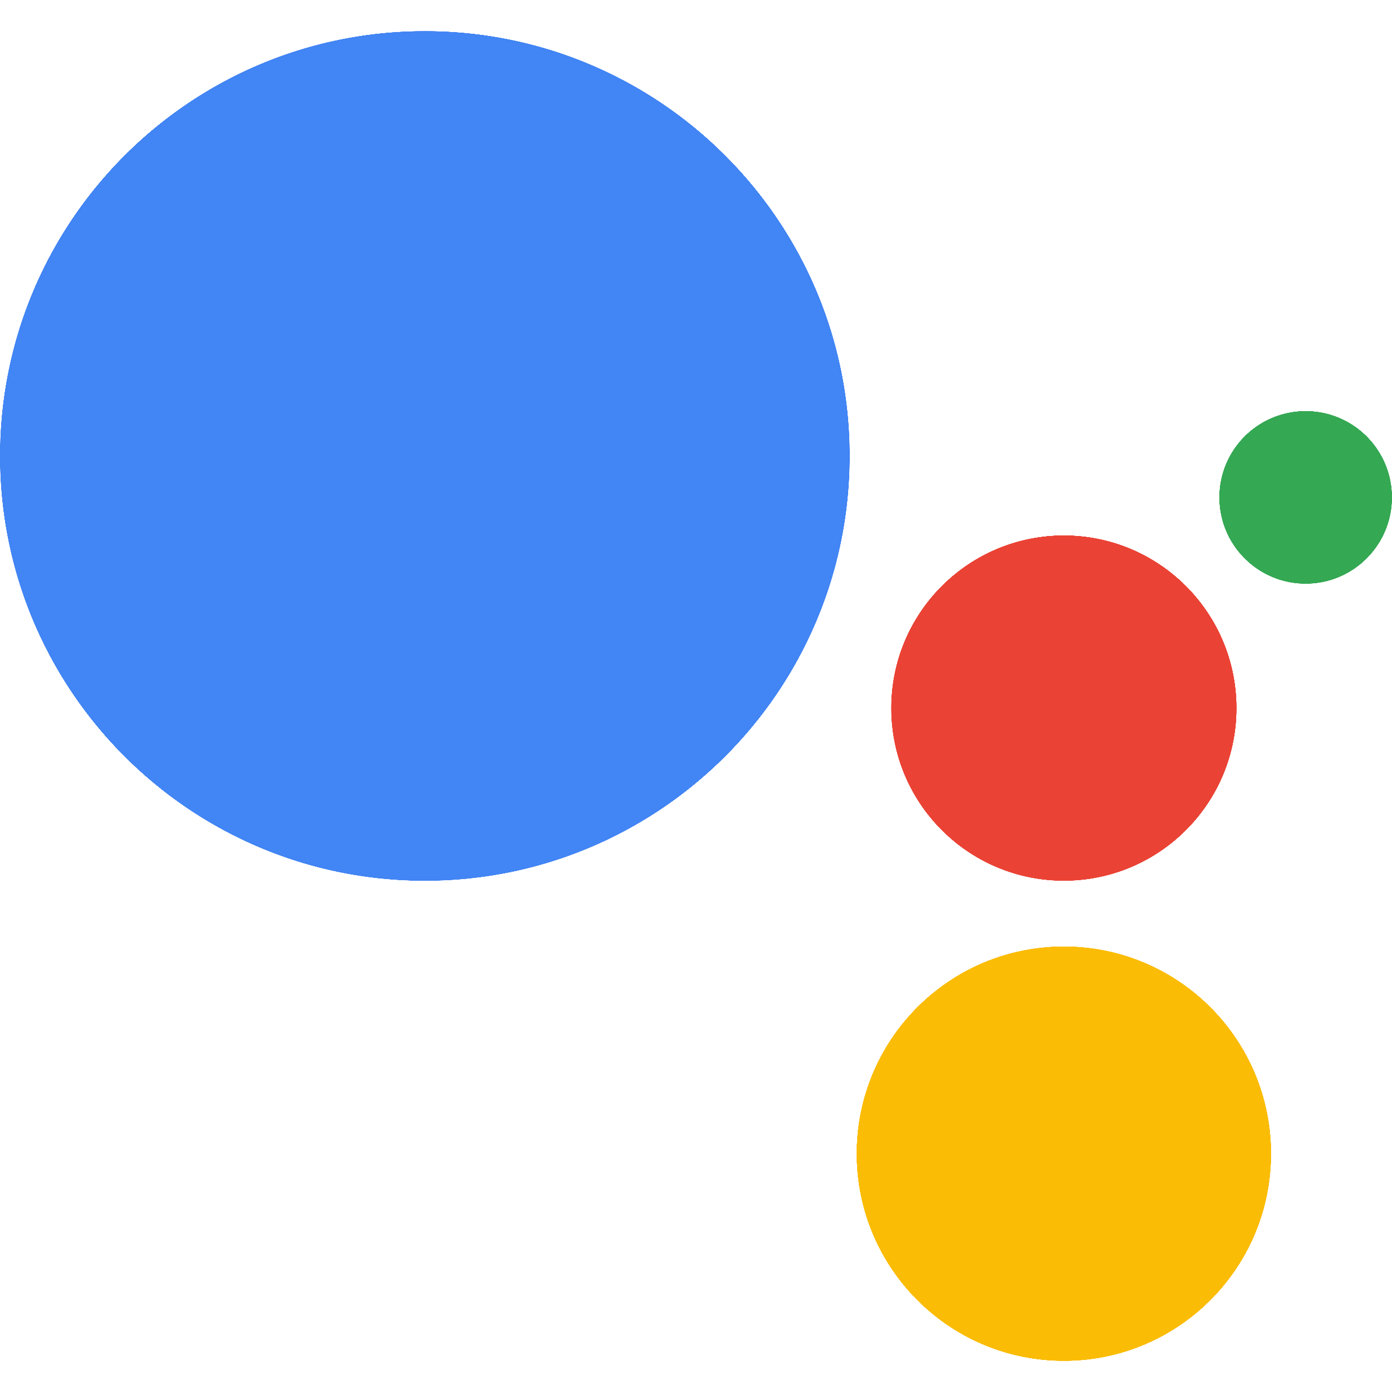
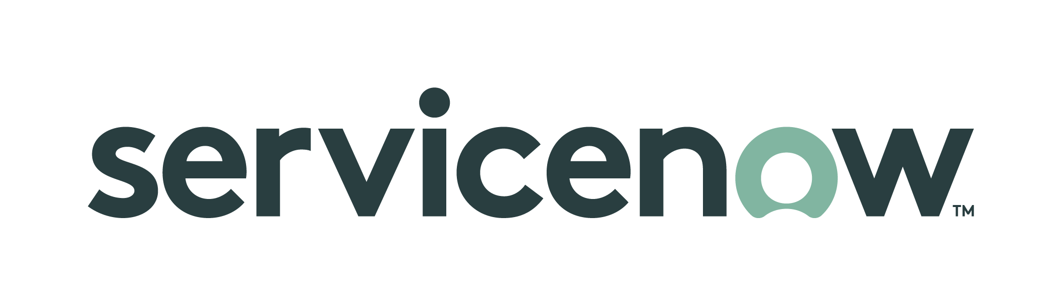

How to get started
Customer success – Immediate ROI
One organization replaced calls normally averaging 3.5 minutes at $1/call minute (industry standard) with conversational AI, leading to estimated cost savings of $1.5 million per year.
ONE-CLICK Deployment
The Conversational Azure OpenAI Accelerator enables you to create informational content one time, deploy it, and manage it simultaneously across the channels of your choosing with just one click.
Website
Chatbot
IVR/
Telephony
BOT Framework Skill
Easily extend your content to other popular channels
Simultaneously deploy conversational content to voice assistants
Enterprise integration modules for common systems
Microsoft Teams
SMS Messaging
WhatsApp
Amazon Alexa
Slack
FB Messenger
Instagram
Google Assistant
Learn More with a No-Cost, No Obligation Proof of Concept.
Request a rapid POC tailored to your use case showcasing your conversations & tasks automated.
Request via email at OpenAIAccel@microsoft.com CC: Azure_AI_Accelerator@zammo.ai.
Enrich your contact center with Azure OpenAI
Kick-off
Proof of value
Proof of concept
Learn more about the Conversational Azure OpenAI Accelerator and see a demo.
Platform demonstration based on your business content, workflows, and channel needs.
Minimum Viable Product (MVP) or Proof of concept includes connection to your backend systems.
Contact your Microsoft specialist for a demo and to discuss prerequisites, next steps, and your questions.
©Microsoft Corporation. All rights reserved.

